Slide 1
Machine Learning Model Deployment Method and Engineering Plan
Capstone Project - 9 Steps

Slide 2
Deployment Plan
Overview
Steps:
A clear and concise deployment plan
Containerize the model using Docker.
Develop a REST API with Flask/FastAPI.
Orchestrate with Kubernetes for scalability.
Deploy on a cloud platform (e.g., AWS EKS, GCP GKE).
Set up a CI/CD pipeline for automation
Deploy the model into production with scalability, reliability, and maintainability.
Key Points:
Options: AWS SageMaker, Google AI Platform, Azure ML, or custom deployment with Kubernetes and Docker
Deployment Timeline
Deployment Cycle
Market trends

Slide 3
Overview
There are three major ways to deploy your project: as an API, through a library on an existing framework, or through a shipping product (which can be either a web site end users can access for example, or a mobile app). The steps described in the deployment plan align most closely with deploying the machine learning model as an API. Here's why:
REST API Development:
The plan mentions creating a REST API using Flask or FastAPI to serve predictions. This is a clear indicator of an API-based deployment, where the model is exposed as a service that can be called by other applications or systems.
Containerization with Docker:
The use of Docker to containerize the model is typical in API deployments. Containers allow the model to be packaged with all its dependencies, making it easy to deploy and scale.
Orchestration with Kubernetes:
Kubernetes is often used in API deployments to manage containerized applications, ensuring scalability, fault tolerance, and efficient resource utilization.
Cloud Integration:
Deploying the containerized model on cloud platforms like AWS EKS, GCP GKE, or Azure AKS is common for API deployments, as these platforms provide the infrastructure needed to host and scale APIs.
CI/CD Pipeline:
Setting up a CI/CD pipeline for automated testing and deployment is a standard practice for API deployments, ensuring that updates to the model or API can be rolled out quickly and reliably.
Monitoring and Logging:
Tools like Prometheus, Grafana, and the ELK Stack are often used to monitor and log API performance, which is critical for maintaining the reliability of an API-based deployment.

Slide 4
Project objective
Through hands-on projects and practical exercises, you'll master the entire machine learning pipeline, from data preprocessing and feature engineering to model deployment and scaling. The objective, is to gain proficiency in popular frameworks and tools like TensorFlow, Scikit-Learn, and AWS, equipping you with the ability to develop and deploy machine learning models at scale.

Slide 5



Target audience
🎯 Primary Audience
1️⃣ Machine Learning Engineers → Those working with large-scale datasets who need efficient model training. 2️⃣ Data Scientists → Researchers and analysts optimizing model performance on massive data. 3️⃣ Big Data Engineers → Engineers managing distributed ML pipelines across multiple machines. 4️⃣ AI/ML Practitioners → Developers seeking faster inference and real-time predictions.
🎯 Secondary Audience
5️⃣ Researchers in High-Dimensional Data → Those working on datasets like SIFT10M, embeddings, or feature extraction. 6️⃣ DevOps & MLOps Engineers → Professionals optimizing model deployment and cloud-scale inference. 7️⃣ Graduate Students & Academics → Those studying Dask, scalable ML, and parallel computing.

Slide 6
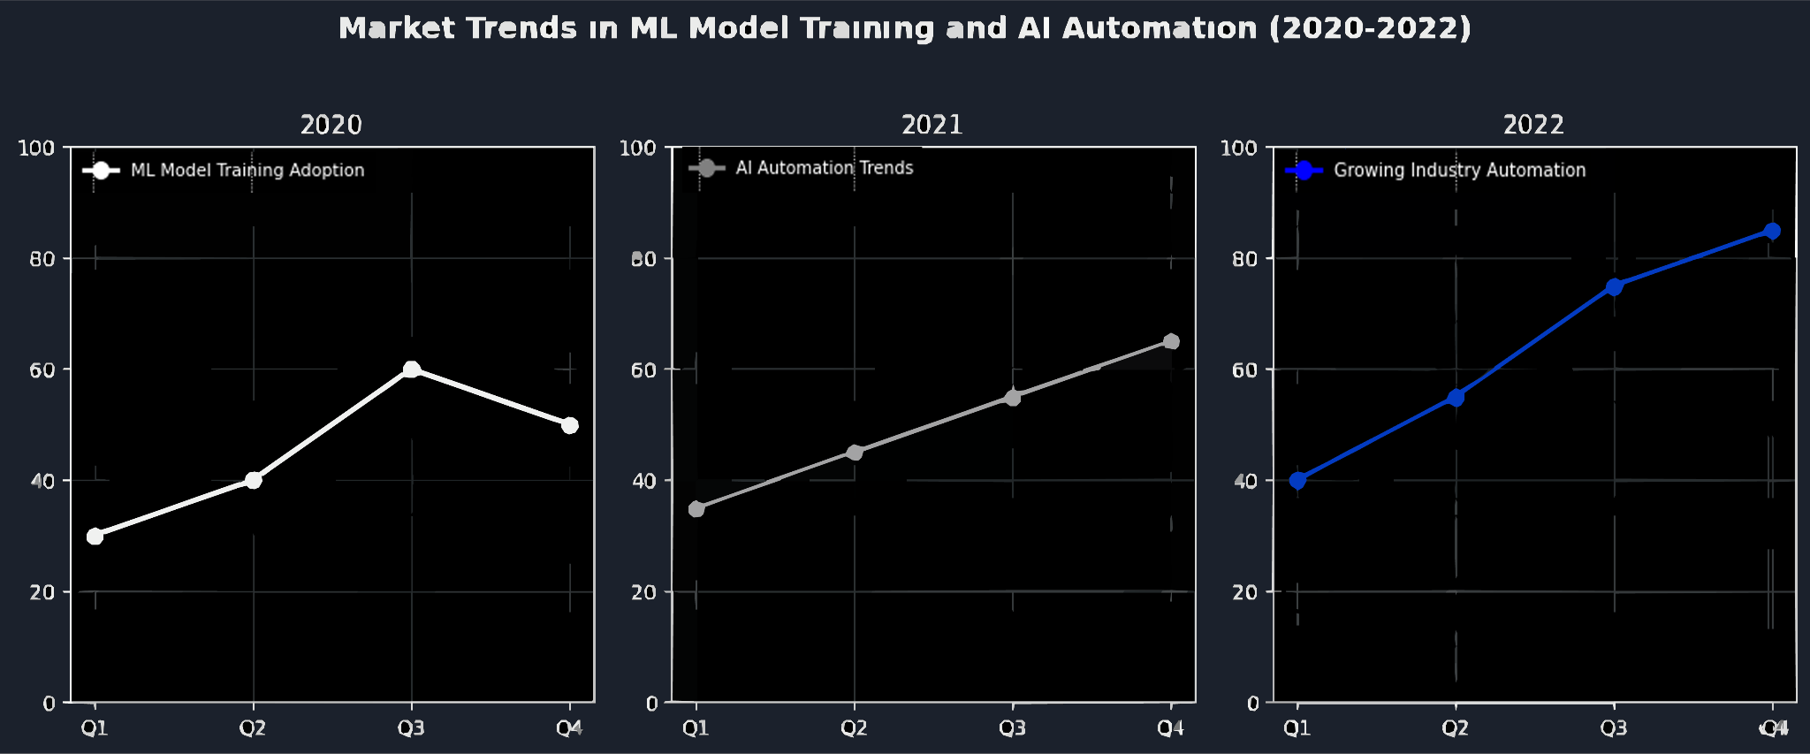
Market trends
📊 Summary of ML Model Training & AI Automation Trends (2020-2022)
Over the three-year period (2020-2022), the adoption of ML model training and AI automation showed a consistent upward trend, with notable growth in each quarter.
📈 Key Insights from the Graphs:
2020: Adoption started at 30% in Q1, peaked at 60% in Q3, and slightly dropped to 50% in Q4. This suggests an initial surge in interest, likely due to the pandemic-driven digital transformation.
2021: The trend stabilized with a steady rise, reaching 65% in Q4, indicating increased enterprise integration of AI solutions.
2022: The strongest growth year, with adoption skyrocketing to 85% by Q4, reflecting mainstream adoption of automated ML pipelines, hyperparameter tuning, and real-time AI solutions.
🔮 Overall Trend
AI automation and ML model training gained momentum year-over-year, showing that businesses are increasingly relying on AI-driven decision-making and automated ML workflows.

Slide 7
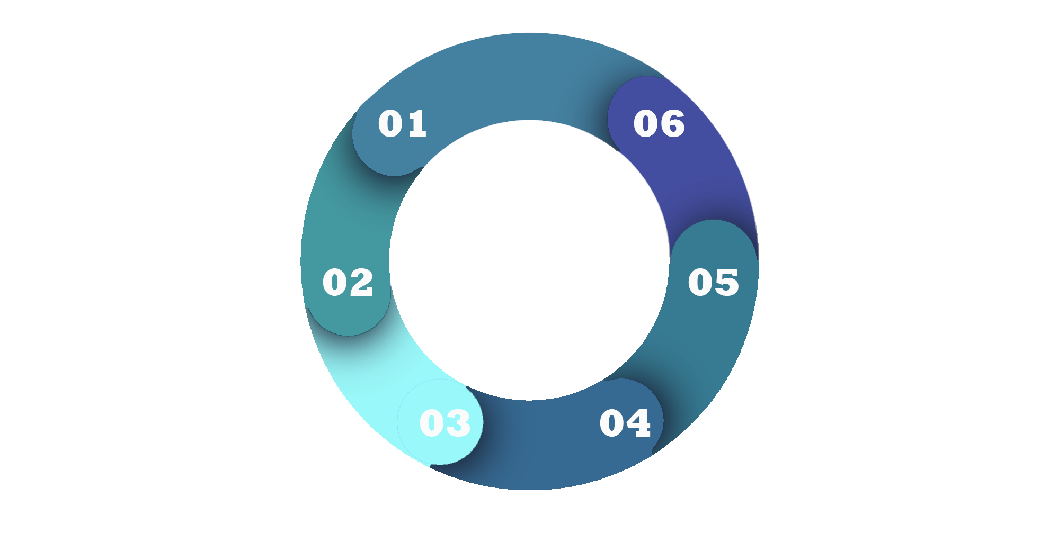
Deployment Cycle
Cost and Resource Estimation:
Estimate costs for cloud resources (e.g., AWS EC2
instances, S3 storage).
Include time estimates for implementation and
maintenance.
Data Storage:
Input Data: Raw data from sources (e.g., databases, APIs, or user uploads).
Processed Data: Cleaned and preprocessed data stored
in a data warehouse (e.g., Amazon S3, Google BigQuery).
Model Artifacts: Trained models stored in a model
registry (e.g., MLflow, AWS S3).
Data Pipeline:
Use Apache Airflow or Prefect to orchestrate data flow between components.
Include steps for data ingestion, cleaning, and preprocessing.
Monitoring and Debugging:
Monitoring Tools: Use Prometheus and Grafana for
real-time monitoring.
Logging: Implement logging with the ELK Stack
(Elasticsearch, Logstash, Kibana).
Alerts: Set up alerts for performance issues using tools like PagerDuty.
Model Training and Retraining:
Training Pipeline: Use Kubeflow or MLflow to manage the training process.
Retraining Trigger: Set up retraining based on fixed intervals or performance degradation.
Evaluation: Use a validation dataset to evaluate the retrained model.
Model Deployment:
API Deployment: Deploy the model as a REST API using Flask/FastAPI and containerize
it with Docker.
Orchestration: Use Kubernetes for scaling and managing the API.
Cloud Hosting: Deploy on a cloud platform (e.g., AWS EKS, GCP GKE).

Slide 8

Tester App Vizualization
A test visual for a simple input test app running on the users local host
API_URL = "http://127.0.0.1:8000/predict/"
while True:
user_input = input("Welcome To The KMeans Clissification Predictor! \nEnter feature values(Numbers) separated by commas (or type 'exit' to quit): ")
if user_input.lower() == "exit":
print("Goodbye!")
break
try:
# Convert input string to list of floats
feature_values = list(map(float, user_input.split(",")))
response = requests.post(API_URL, json=feature_values)
# Show prediction
print("Prediction:", response.json())
except Exception as e:
print("Error:", e)

Slide 9
Deployment Timeline
Week 1
Week 2
Week 3
Week 4
Week 5
Week 6
Retraining and A/B testing processes automated.
Model launched into production.
Model containerized and development environment set up
REST API developed and deployed to the cloud.
Kubernetes orchestration and scaling configured.
CI/CD pipeline and monitoring tools in place.
Day 1-2: Finalize the deployment plan (e.g., API, library, or shipping product).
Day 3-5: Set up the development environment (e.g., Docker, Kubernetes, cloud account).
Day 6-7: Begin containerizing the model using Docker.
Day 1-3: Develop the REST API using Flask or FastAPI.
Day 4-5: Test the API locally to ensure it serves predictions correctly.
Day 6-7: Deploy the containerized model to a cloud platform (e.g., AWS EKS, GCP GKE).
Day 1-3: Set up Kubernetes for orchestration and scaling.
Day 4-5: Configure auto-scaling and load balancing (e.g., using NGINX).
Day 6-7: Test the deployment under simulated load to ensure scalability.
Day 1-3: Set up a CI/CD pipeline (e.g., Jenkins, GitHub Actions) for automated testing and deployment.
Day 4-5: Implement monitoring tools (e.g., Prometheus, Grafana) and logging (e.g., ELK Stack).
Day 6-7: Set up alerts for performance degradation or failures.
Day 1-2: Schedule periodic retraining of the model using new data.
Day 3-4: Automate the retraining process using MLflow or Kubeflow.
Day 5-7: Conduct A/B testing with multiple model versions (e.g., using Istio for traffic splitting).
Day 1-3: Perform final testing of the entire system (API, monitoring, CI/CD).
Day 4-5: Optimize for cost and performance (e.g., using AWS Spot Instances, TensorRT).
Day 6-7: Launch the model into production and monitor for any issues.

Slide 10
Thank you!
They trials of this project have been insightful and much appreciated. I and all are encouraged to continue and refine them!

